Slide 1
King County Housing
Price Prediction
Zahory Vasquez & Ayse Kocyigit

Slide 2
Steps taken
Dataset: 21,634 house sales with 21 features
Understanding drivers of housing prices
Build machine learning models to predict sale prices
Improve model performance through feature and parameter tuning

Slide 3
Data Cleaning & EDA
Inspected data shape, types, duplicates and missing values
Converted date to year and month
Created Historgrams & boxplots: checked distributions, outliers
Correlation Heatmap

Slide 4
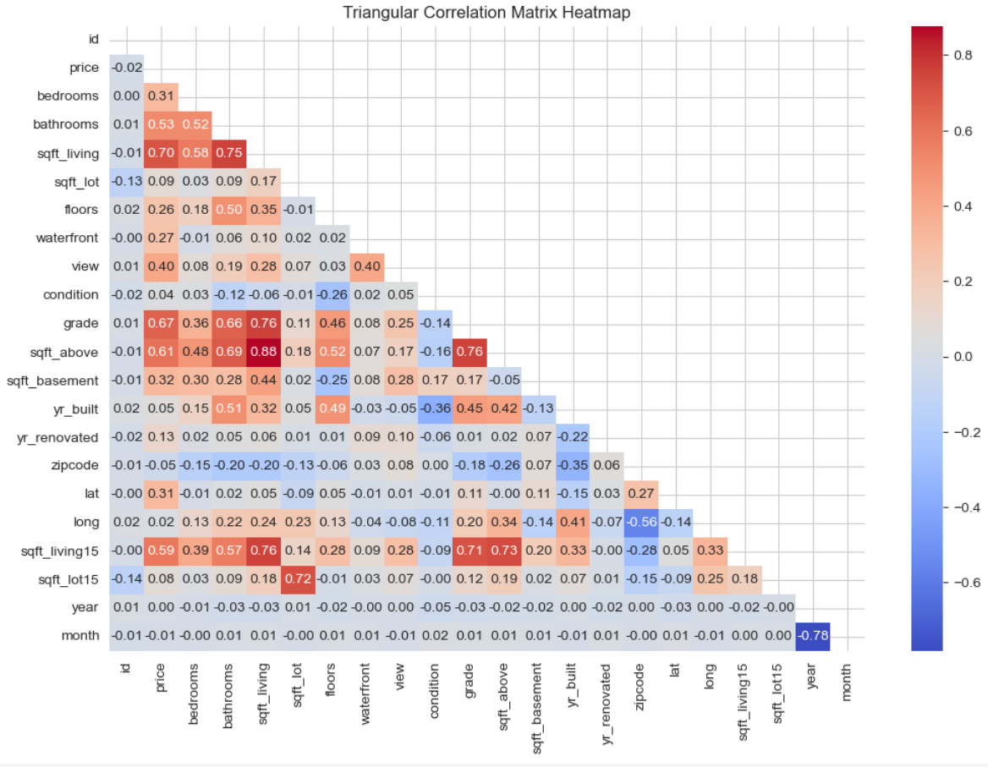

Slide 5
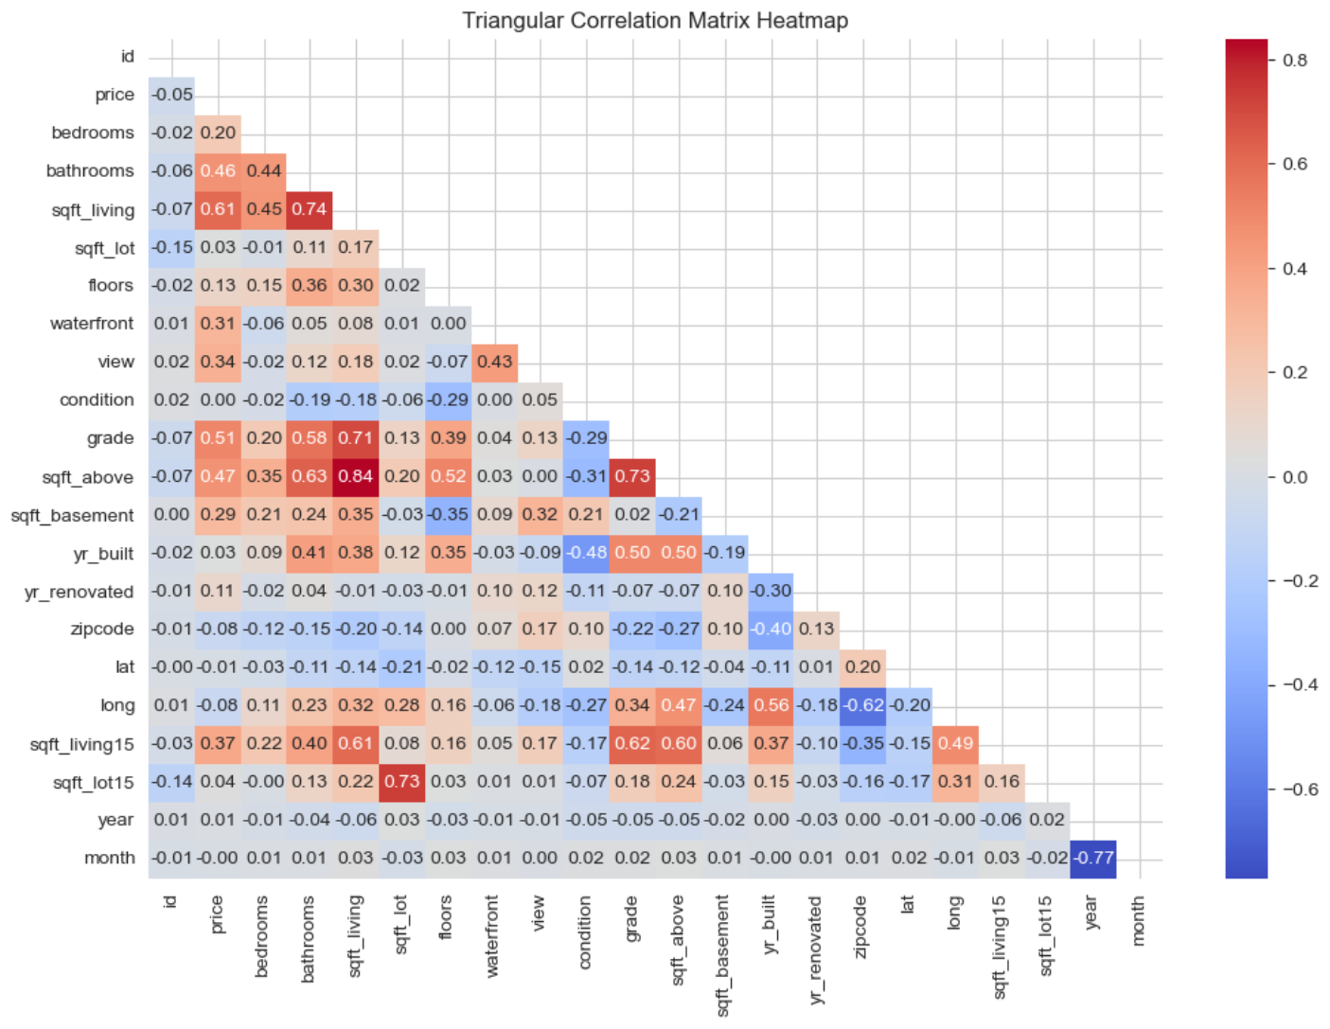

Slide 6
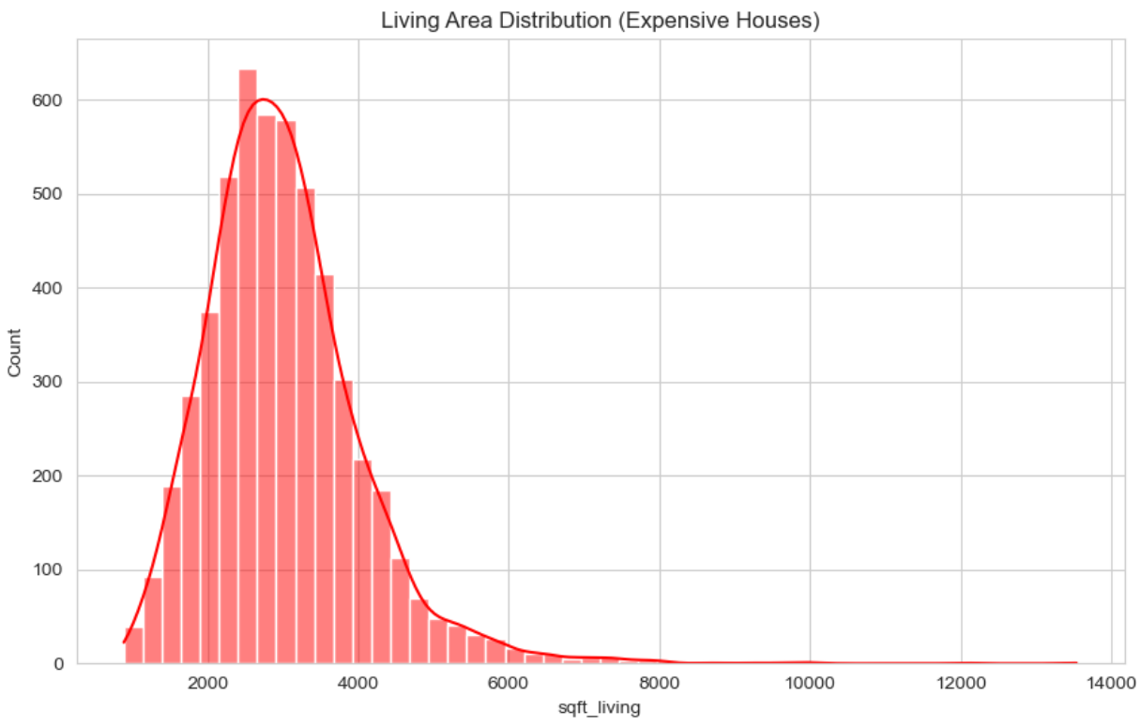
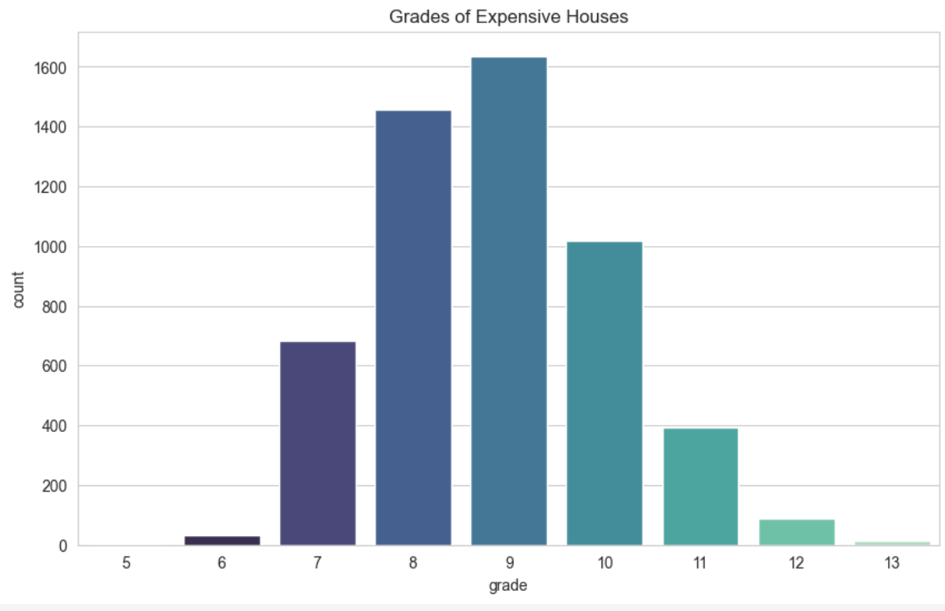
Strongest Correlation Features of Expensive Houses

Slide 7
Machine Learning Models
KNN Regressor
Linear Regression
Random Forest Regressor
XGB Regressor
Metrics:
RMSE
R²

Slide 8
KNN Results
RMSE~300k, R² ~0.25
Overfit: performed better on training but poorly on test
Struggles because
Noisy data with outliers -> nearest neighbors don’t generalize
No scaling applied initially (important for KNN)
Conclusion: KNN is too simplistic for this dataset, housing prices depend on more than just “similar” neighbors in raw feature space.

Slide 9
Linear Regression Results
RMSE ≈ 200–360k, R² ≈ 0.70
Coefficients show how features relate linearly to prive
Strengths: captures main trends (Larger living area -> higher price; higher grade -> premium)
Limitations: assumes linear relationships, sensitive to outliers and multicollinearity
Conclusion: A good baseline that explains ~70% of price variance, but leaves ~30% unexplained due to non-linear interactions and complex geography.

Slide 10
Random Forest Results
RMSE ≈ 114k, R² ≈ 0.89
Great performance on both train and test -> good generalization
Captures non-linearities and feature interactions
Naturally robust to outliers and irrelevant features
Conclusion: Random Forest is a strong model, but can be computationally heavier, and feature importance can be biased toward continuous variables.

Slide 11
XGBoost Results
RMSE ≈ 111k, R² ≈ 0.897
Slightly better than Random Forest
Advantages:
Gradient boosting -> sequentially reduces errors from previous trees
Regularization -> prevents overfitting
More flexible than Random Forest in handling complex patterns
Conclusion: XGBoost emerged itself as the best baseline model - combining accuracy with robustness.

Slide 12
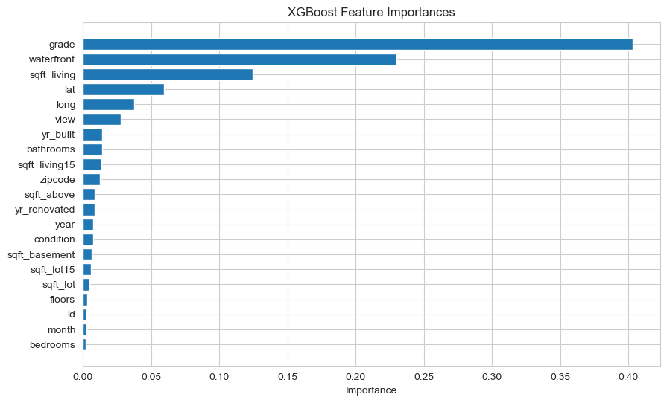

Slide 13
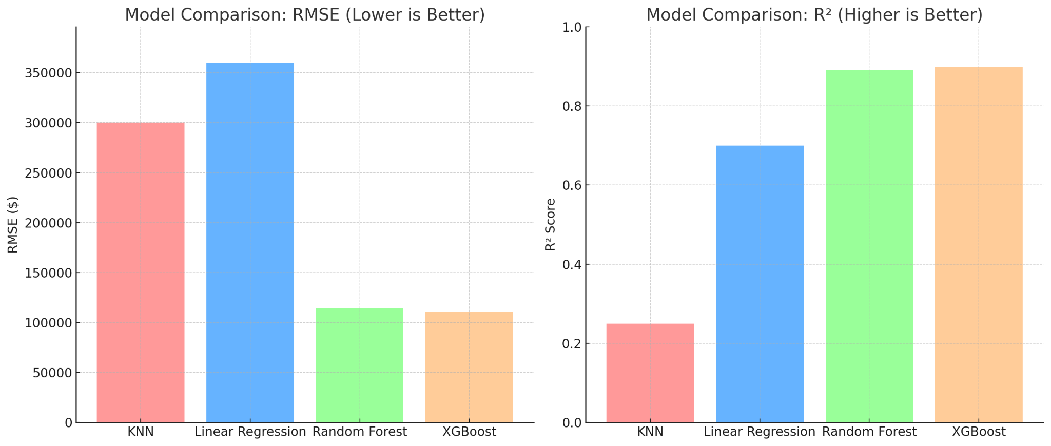
Machine Learning Models Comparison

Slide 14
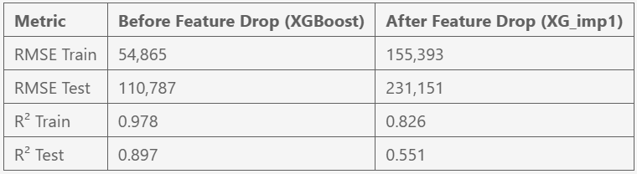
Improving the Data
Attempt 1: drop low correlation-features (less than 50%)
(Refer to slide #4)
(id, bedrooms, sqft_lot, floors, waterfront, view, condition, sqft_basement, yr_built, yr_renovated, zipcode, lat, long, sqft_lot15, year ,month)

Slide 15
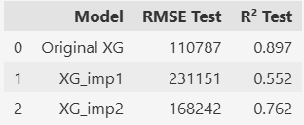
Attempt 2: drop low-importance features from XGB (less than 0,05)
(Refer to slide #12)
(bedrooms, month, id, floors, sqft_lot15, sqft_lot, sqft_basement, condition, year, yr_renovated, sqft_above, zipcode, sqft_living15, bathrooms, yr_built, view, long)

Slide 16
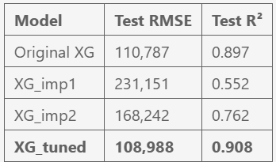
Improving the Model
Fitting 3 folds for each of 20 candidates, totalling 60 fits
Best params: {'subsample': 0.7, 'n_estimators': 900, 'max_depth': 5, 'learning_rate': 0.1, 'colsample_bytree': 0.9}
The tuned XGBoost model (XG_tuned) is the best performing model so far.
It has higher R² and lower RMSE than all previous versions, showing that hyperparameter tuning effectively improved predictive performance.
Compared to XG_imp2 (best previous improvement), RMSE decreased (~168k → ~109k) and R² increased (~0.762 → ~0.908), meaning that model now predicts prices more accurately.

Slide 17
King County Housing
Price Prediction
Zahory Vasquez & Ayse Kocyigit

